Slide 1
Sinclair Digital Thread Initiative
Digital Dayton Roundtable
March 2023

Slide 2
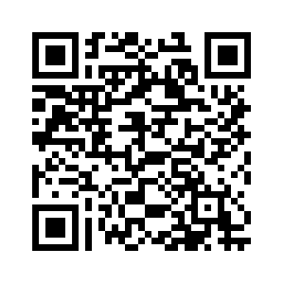
Digital Tapestry Series
Digital Thread Bytes Podcast
New Episode Available Now
Upcoming Workshop
March 8th

Slide 3
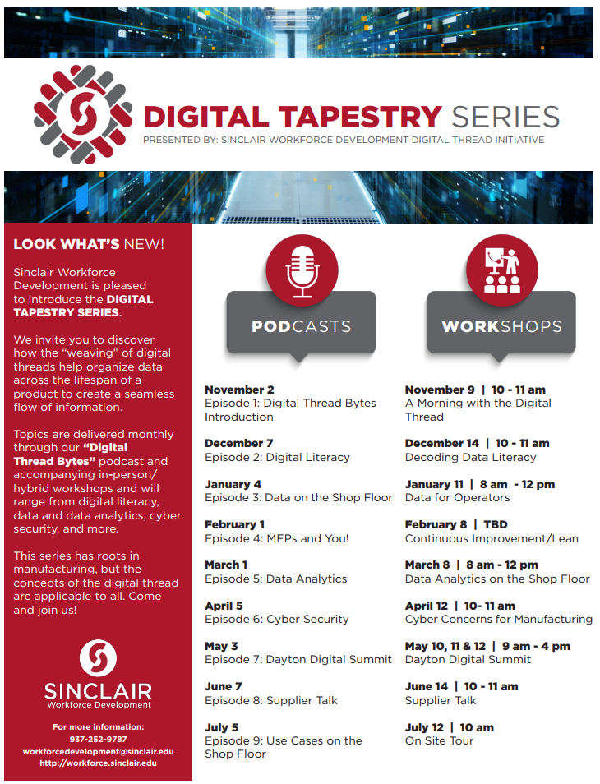
Digital Tapestry Series

Slide 4
