Slide 1
Sinclair Digital Thread Initiative
Digital Dayton Roundtable
February 2023

Slide 2
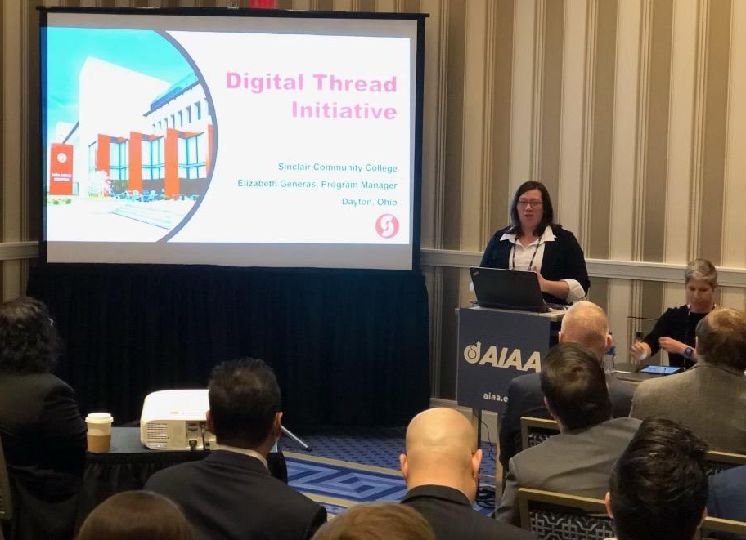
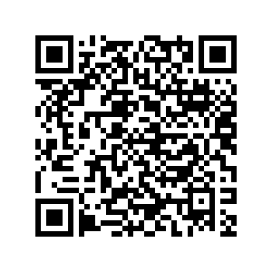
Sinclair Digital Thread Initiative

Slide 3
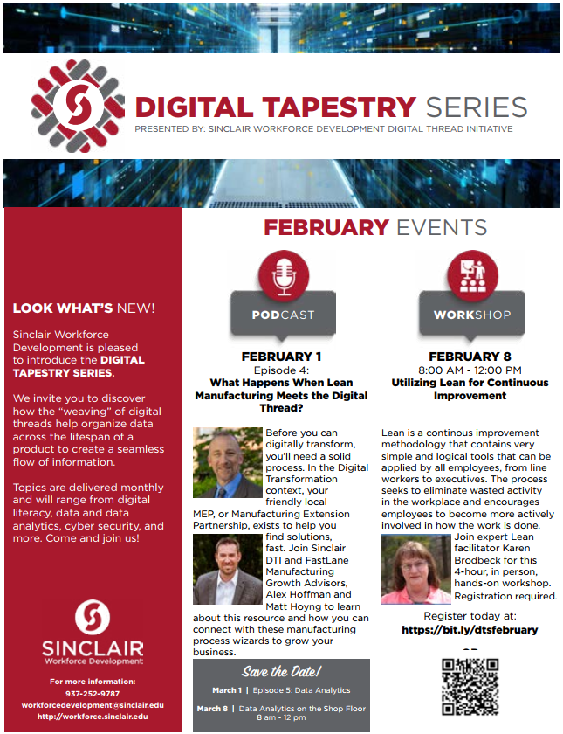
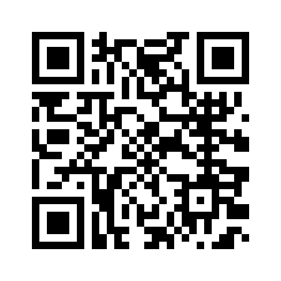
Digital Tapestry Series
Digital Thread Bytes Podcast
New Episode Available Now
Upcoming Workshop
February 8th

Slide 4
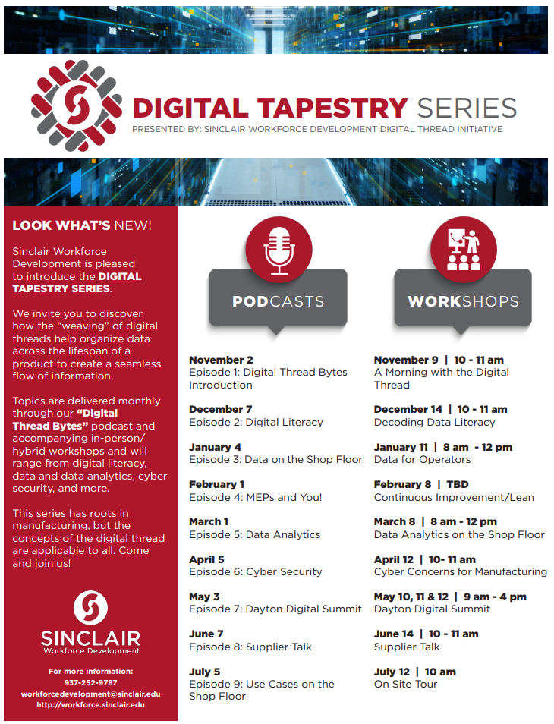
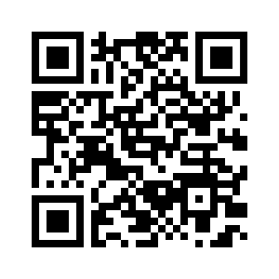
Digital Tapestry Series

