Slide 1


DAF Digital Transformation
J. Kyle Hurst Chief, Digital Transformation Office
23 Oct 2022

Slide 2
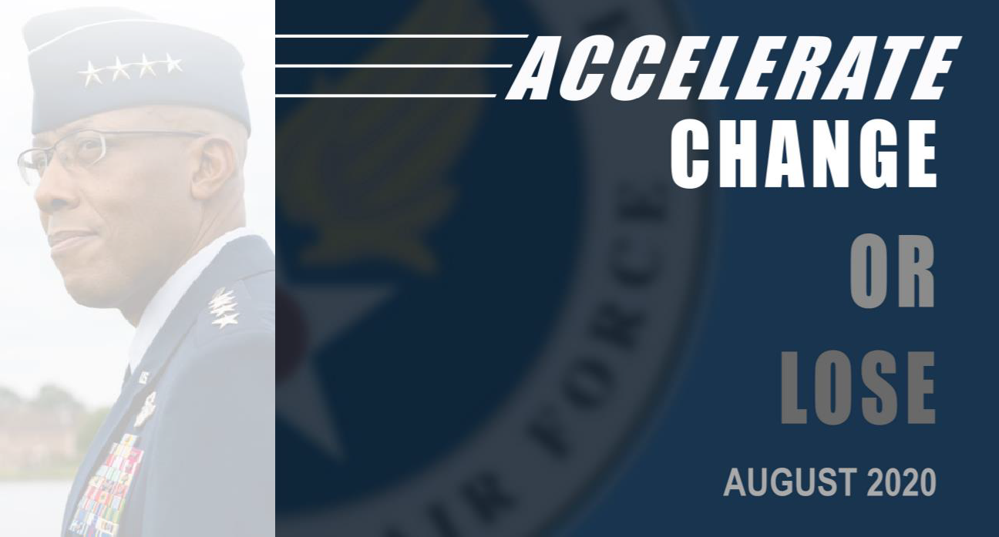
Background
?
“The current acquisition process is not built to maintain our advantage in tomorrow’s fight”
“We are seeing competitors outpace our current fielding timelines”
“Good enough today will fail tomorrow”
“Victory smiles upon those who anticipate the change in the character of war, not upon those who wait to adapt themselves after the changes occur.” — Giulio Douhet
UNCLASSIFIED
Briefer: Kyle Hurst, DAF DTO

Slide 3
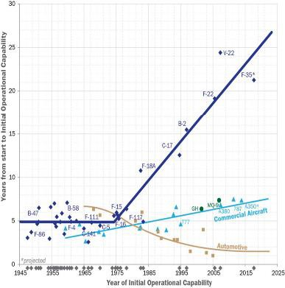
“it takes the US on average sixteen years to deliver an idea to operational capability, versus fewer than seven for China”
“The PPBE’s inflexibility increases the difficulty of rapidly shifting funding to emergent innovations”
“Defense acquisition process and legacy defense industrial base approach struggle to accommodate timely adoption of these emerging technologies”
“Competitive advantage in decision-centric operations (whether budgeting or on the battlefield) comes from the scale of available options, tempo of decision- making, and superior decision processes”
Average time to reach IOC by year
Source: Patt, W. G. (2021). Competing in Time: Ensuring Capability Advantage and Mission Success through Adaptable Resource Allocation
Digital Transformation yields smarter, faster decision making; but flexible funding and agility in HOW we resource is essential
3

Slide 4
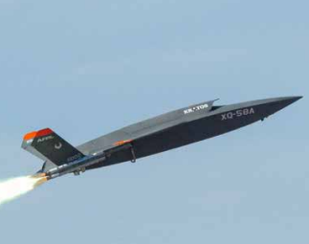

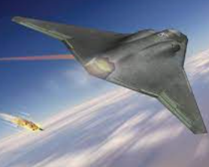
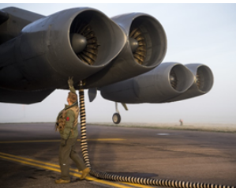
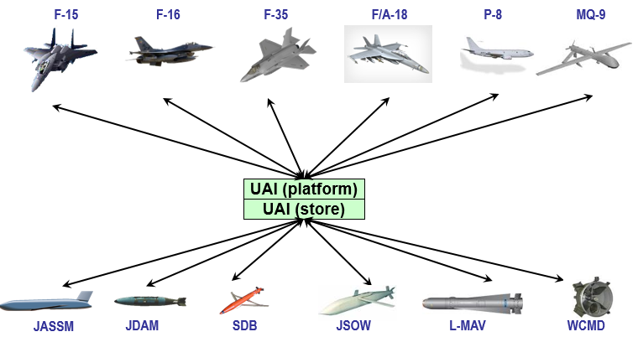
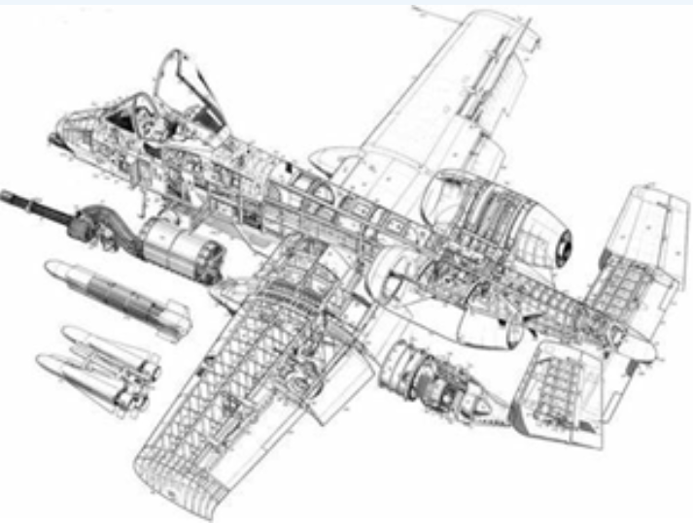
Better Capability, Faster
Research
Develop
Test
Sustain
Maintain
Design
Supply
Retire
Prototype
Requirements
Analysis
DT & OT
SLEP
Modernize
DMSMS
Skyborg
Sentinel
NGAD
B-52 CERP
UAI
A-10 Re-Wing
  First flight in 36 mo from concept dev.
  Modularity enables >10 variations
  Digital models enables rapid design/test/validate cycles w/warfighter feedback
  >6B design variants analyzed to optimize performance
  ~6 month reduction in time to SRR
  VR based training for operators/MX
  Months → Days for software development & release
  1000's of high fidelity design iterations
  Months → Weeks prep time for acq. reviews
  Pivot w/evolving threat
  >60 day reduction in time to PDR w/shared digital tool environment
  Months saved in virtual validation of assembly & MX
  Virtual training opportunities for crews/MX
  >2 yrs, $2M saved in ICD dev’t and SIL testing for F-15/SDB II integration
  For NATO munitions: 19 & 15 months saved on wpn integration compared to 5 year nominal avg
  ~1 yr saved in design qualification
  ~60% reduction in sustainment eng response time
  2000 hrs or A/C downtime reduced to 700 hrs
Model Based System Engineering (MBSE)
Threat Informed Mission Modeling
Acquisition Data Management
Open Standards
Reference Architectures
Automated Certification Processes
Authoritative Sources of Truth (ASoT)
PLM & linkage to Log-IT
Foundational Supporting Capabilities
Enterprise Tools
Robust IT Infrastructure
Workforce Training
Enterprise Policy & Governance
Digital Culture
Overcoming silo’s and enabling enterprise scale requires enterprise investment

Slide 5
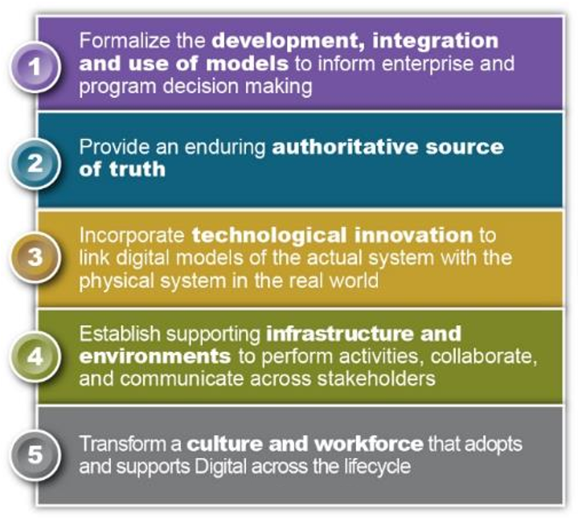

Background
VISION: A digitally-empowered DAF equipped with an agile workforce, state-of-the-art tech, and intuitive processes that drive model-based enterprise decision-making, enable automation, institutionalize open architectures, and leverage authoritative models and data to ensure seamless stakeholder collaboration across the lifecycle
Status:
Campaign Ongoing >2 years; program level pathfinders; leader support (AFMC, SSC, AQ, SQ)
DTO established in June ‘21, Campaign continued as an all-volunteer force
Published Digital Guide: ~25k views/month w/recurring updates
Conducted Culture Science Assessment; DE Platform deployment/scaling; digital maturity assessment; functional training dev.; Template/contracting language/style guide dev.

Slide 6
Terminology
Digital Engineering: an integrated digital approach that uses authoritative sources of system data and models as a continuum across disciplines to support lifecycle activities from concept through disposal
*Digital Transformation: the integration of digital technology and processes into all areas of our mission, fundamentally changing how we operate and deliver value to stakeholders
*Digital Acquisition: Digital Transformation applied to the Acquisition System/Process
*Digital Materiel Management: Digital Acquisition/Transformation applied with the context of acquiring and sustaining a weapon system or installation
  AFMC Strat Plan Context: The process of integrating and employing digital methods across the entire lifecycle, from invention to retirement, for both warfighting & installation/mission support capabilities
*Working definitions

